Slide 1
Thread synchronization pt. 2

Slide 2
Agenda
Producer-Consumer
Thread synchronization
AutoResetEvent
ManualResetEvent
Queues and BlockingCollection

Slide 3

Water level Monitor System

Slide 4
TPMS design
TyrePressureMonitor has many responsibilities:
Notes:
The Sensor may reply with data formatted in a strange way, which shall be translated.

Slide 5
TPMS design
TyrePressureMonitor has many responsibilities:
Read the pressure using the TyrePressureSensor.
Notes:
The Sensor may reply with data formatted in a strange way, which shall be translated.

Slide 6
TPMS design
TyrePressureMonitor has many responsibilities:
Read the pressure using the TyrePressureSensor.
Determine if the pressure is too low.
Notes:
The Sensor may reply with data formatted in a strange way, which shall be translated.

Slide 7
TPMS design
TyrePressureMonitor has many responsibilities:
Read the pressure using the TyrePressureSensor.
Determine if the pressure is too low.
Turn on/off the PressureLowIndicator
Notes:
The Sensor may reply with data formatted in a strange way, which shall be translated.

Slide 8
Design principle: Single Responsibility
THERE SHOULD NEVER BE
MORE THAN ONE REASON
FOR A CLASS TO CHANGE
Robert Martin: The Single Responsibility Principle

Slide 9
TPMS design
TyrePressureMonitor has many responsibilities:
Read the pressure using the TyrePressureSensor.
Determine if the pressure is too low.
Turn on/off the PressureLowIndicator
Notes:
But every responsibility is a reason.

Slide 10
Now, reading the pressure is separated out.

Slide 11
Now, reading the pressure is separated out.
Wouldn’t it be nice, if the pressure monitor did not have to control when the pressure was read?

Slide 12
Let’s put the TyrePressureReader on a separate thread.

Slide 13
Let’s put the TyrePressureReader on a separate thread.
How does the TyrePressureMonitor know, when a new reading has taken place?

Slide 14
The Monitor consumes data, which the Reader provides.

Slide 15
Producer - Consumer
The Monitor consumes data, which the Reader provides.
This is a very common design: Producer – Consumer.

Slide 16
Producer - Consumer
The Consumer consumes data, which the Provider provides.
Let’s put that data into another object, so the Consumer thread does not have to know the Producer thread.

Slide 17
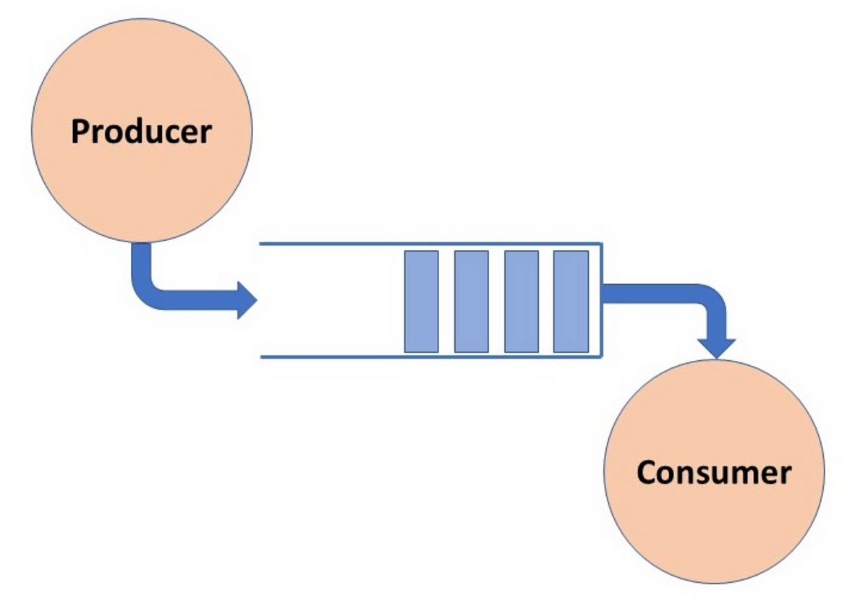

Slide 18
DataContainer
class DataContainer
{
private int tyrePressure;
public int GetTyrePressure()
{
return tyrePressure;
}
public void SetTyrePressure(int value)
{
tyrePressure = value;
}
}
Objects of the DataContainer class is used to pass data from producer to consumer.

Slide 19
Producer - Consumer
The Consumer would like to know when new data is available.
Notes:
Let’s assume, that the DataContainer only can hold a single value.

Slide 20
Producer - Consumer
The Consumer would like to know when new data is available.
The Producer would like to know, if the data has been consumed, so it can provide a new value.
Notes:
Let’s assume, that the DataContainer only can hold a single value.

Slide 21
Thread synchronization

Slide 22
Producer - Consumer
The Consumer would like to know when new data is available.
The Producer would like to know, if the data has been consumed, so it can provide a new value.
We can signal this between threads with Events
DataReadyEvent
Notes:
Let’s assume, that the DataContainer only can hold a single value.

Slide 23
Producer - Consumer
The Consumer would like to know when new data is available.
The Producer would like to know, if the data has been consumed, so it can provide a new value.
We can signal this between threads with Events
DataConsumedEvent
Notes:
Let’s assume, that the DataContainer only can hold a single value.

Slide 24
Queues
But now, the producer and consumer runs in lock-step.

Slide 25
Queues
But now, the producer and consumer runs in lock-step.
To overcome this we can introduce a queue.

Slide 26
Queues
But now, the producer and consumer runs in lock-step.
To overcome this we can introduce a queue.
Question then – which queue to use?

Slide 27
Queues and BlockingCollection

Slide 28
.Net System.Collections.Concurrent
Access to the queue must be thread safe.
We can do this with locks, but...

Slide 29
.Net System.Collections.Concurrent
Access to the queue must be thread safe.
We can do this with locks, but...
.Net has built in thread safe collections:
ConcurrentQueue<T>
ConcurrentStack<T>
ConcurrentBag<T>

Slide 30
.Net System.Collections.Concurrent
Access to the queue must be thread safe.
We can do this with locks, but...
.Net has built in thread safe collections:
ConcurrentQueue<T>
ConcurrentStack<T>
ConcurrentBag<T>
And BlockingCollection<T> which implements the Producer-Consumer pattern.

Slide 31
BlockingCollection<T>
A thread-safe collection class that provides the following features:
https://docs.microsoft.com/en-us/dotnet/standard/collections/thread-safe/blockingcollection-overview
Notes:
Det lyder lige som noget vi har brug for.

Slide 32
BlockingCollection<T>
A thread-safe collection class that provides the following features:
An implementation of the Producer-Consumer pattern.
https://docs.microsoft.com/en-us/dotnet/standard/collections/thread-safe/blockingcollection-overview
Notes:
Det lyder lige som noget vi har brug for.

Slide 33
BlockingCollection<T>
A thread-safe collection class that provides the following features:
An implementation of the Producer-Consumer pattern.
Concurrent adding and taking of items from multiple threads.
https://docs.microsoft.com/en-us/dotnet/standard/collections/thread-safe/blockingcollection-overview
Notes:
Det lyder lige som noget vi har brug for.

Slide 34
BlockingCollection<T>
A thread-safe collection class that provides the following features:
An implementation of the Producer-Consumer pattern.
Concurrent adding and taking of items from multiple threads.
Optional maximum capacity.
https://docs.microsoft.com/en-us/dotnet/standard/collections/thread-safe/blockingcollection-overview
Notes:
Det lyder lige som noget vi har brug for.

Slide 35
BlockingCollection<T>
A thread-safe collection class that provides the following features:
An implementation of the Producer-Consumer pattern.
Concurrent adding and taking of items from multiple threads.
Optional maximum capacity.
Insertion and removal operations that block when collection is empty or full.
Insertion and removal "try" operations that do not block or that block up to a specified period of time.
https://docs.microsoft.com/en-us/dotnet/standard/collections/thread-safe/blockingcollection-overview
Notes:
Det lyder lige som noget vi har brug for.

Slide 36
BlockingCollection<T>
A thread-safe collection class that provides the following features:
An implementation of the Producer-Consumer pattern.
Concurrent adding and taking of items from multiple threads.
Optional maximum capacity.
Insertion and removal operations that block when collection is empty or full.
Insertion and removal "try" operations that do not block or that block up to a specified period of time.
Encapsulates any collection type that implements IProducerConsumerCollection<T>
https://docs.microsoft.com/en-us/dotnet/standard/collections/thread-safe/blockingcollection-overview
Notes:
Det lyder lige som noget vi har brug for.

Slide 37
BlockingCollection<T> - Producer
class Producer
{
private readonly BlockingCollection<DataContainer> _dataQueue;
private readonly Random _random = new Random();
public Producer(BlockingCollection<DataContainer> dataQueue)
{
_dataQueue = dataQueue;
}
public void Run()
{
int cnt = 50;
while (cnt > 0)
{
int pressure = _random.Next(0, 50);
DataContainer reading = new DataContainer();
reading.SetTyrePressure(pressure);
_dataQueue.Add(reading);
Thread.Sleep(10);
cnt--;
}
_dataQueue.CompleteAdding();
}
}
We’ll use a BlockingCollection as the queue.
The BlockingCollection handles all synchronization.

Slide 38
BlockingCollection<T> - Producer
class Producer
{
private readonly BlockingCollection<DataContainer> _dataQueue;
private readonly Random _random = new Random();
public Producer(BlockingCollection<DataContainer> dataQueue)
{
_dataQueue = dataQueue;
}
public void Run()
{
int cnt = 50;
while (cnt > 0)
{
int pressure = _random.Next(0, 50);
DataContainer reading = new DataContainer();
reading.SetTyrePressure(pressure);
_dataQueue.Add(reading);
Thread.Sleep(10);
cnt--;
}
_dataQueue.CompleteAdding();
}
}
We’ll use a BlockingCollection as the queue.
The BlockingCollection handles all synchronization.
Calling CompleteAdding() signals to the receiver, that it shall expect no more data.

Slide 39
BlockingCollection<T> - Consumer
class Consumer
{
private readonly BlockingCollection<DataContainer> _dataQueue;
public Consumer(BlockingCollection<DataContainer> dataQueue)
{
_dataQueue = dataQueue;
}
public void Run()
{
while (!_dataQueue.IsCompleted)
{
try
{
var container = _dataQueue.Take();
int pressure = container.GetTyrePressure();
System.Console.WriteLine("Tyre pressure: {0}", pressure);
}
catch (InvalidOperationException)
{
// IOE means that Take() was called on a completed collection.
}
Thread.Sleep(10);
}
System.Console.WriteLine("No more data expected");
}
}
The consumer takes data from the queue, until IsCompleted is set to true (by CompleteAdding() by the producer).
Notes:
// InvalidOperationException means that Take() was called on a completed collection.
// Some other thread can call CompleteAdding after we pass the
// IsCompleted check but before we call Take.
// In this example, we can simply catch the exception since the
// loop will break on the next iteration.

Slide 40
BlockingCollection<T> - Consumer
class Consumer
{
private readonly BlockingCollection<DataContainer> _dataQueue;
public Consumer(BlockingCollection<DataContainer> dataQueue)
{
_dataQueue = dataQueue;
}
public void Run()
{
while (!_dataQueue.IsCompleted)
{
try
{
var container = _dataQueue.Take();
int pressure = container.GetTyrePressure();
System.Console.WriteLine("Tyre pressure: {0}", pressure);
}
catch (InvalidOperationException)
{
// IOE means that Take() was called on a completed collection.
}
Thread.Sleep(10);
}
System.Console.WriteLine("No more data expected");
}
}
The consumer takes data from the queue, until IsCompleted is set to true (by CompleteAdding() by the producer).
Remember try-catch around the Take() invocation. The queue might be marked as completed.
Notes:
// InvalidOperationException means that Take() was called on a completed collection.
// Some other thread can call CompleteAdding after we pass the
// IsCompleted check but before we call Take.
// In this example, we can simply catch the exception since the
// loop will break on the next iteration.

Slide 41
BlockingCollection<T> - Creation
static void Main(string[] args)
{
BlockingCollection<DataContainer> dataQueue = new
BlockingCollection<DataContainer>();
Producer producer = new Producer(dataQueue);
Consumer consumer = new Consumer(dataQueue);
Thread producerThread = new Thread(producer.Run);
Thread consumerThread = new Thread(consumer.Run);
producerThread.Start();
consumerThread.Start();
Console.ReadKey();
}

Slide 42
BlockingCollection – Add/Take with timeouts
public bool TryAdd (T item, int millisecondsTimeout);
If you have something else for the thread to do, you can use timeouts on the Add and Take method.
public bool TryTake (out T item, TimeSpan timeout);
See code examples on:
https://docs.microsoft.com/en-us/dotnet/standard/collections/thread-safe/how-to-add-and-take-items

Slide 43

Your turn
Solve exercises 1, 2 and 3
(and 4, 5 and 6 if you like)

Slide 44
Thread communication with Events

Slide 45
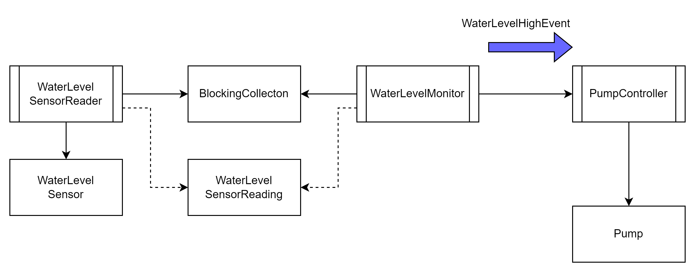
A WaterLevelSensor reads the water level.
The reading is sent to a WaterLevelMonitor.
If the water level is too high, it sends an event to a PumpController, which runs a pump for a given time.

Slide 46
A WaterLevelSensor reads the water level.
The reading is sent to a WaterLevelMonitor.
If the water level is too high, it sends an event to a PumpController, which runs a pump for a given time.
Notes:
Let’s look at the part with the Events.

Slide 47
AutoResetEvent and ManualResetEvent
Event handles can be used to signal from one thread to another.

Slide 48
AutoResetEvent and ManualResetEvent
Event handles can be used to signal from one thread to another.
AutoResetEvent changes from signaled to unsignaled automatically any time it activates a thread.

Slide 49
AutoResetEvent and ManualResetEvent
Event handles can be used to signal from one thread to another.
AutoResetEvent changes from signaled to unsignaled automatically any time it activates a thread.
ManualResetEvent allows any number of threads to be activated by its signaled state, and will only revert to an unsignaled state when its Reset method is called.

Slide 50
WaterLevelMonitor
public class WaterLevelMonitor
{
private readonly AutoResetEvent _waterLevelHighAutoResetEvent;
private readonly Random _random = new Random();
public WaterLevelMonitor(AutoResetEvent waterLevelHighAutoResetEvent)
{
_waterLevelHighAutoResetEvent = waterLevelHighAutoResetEvent;
}
public void Run()
{
for (int i = 0; i < 10; i++)
{
int randomValue = _random.Next(0, 2);
Console.WriteLine("Random value was: {0}", randomValue);
if (randomValue > 0)
{
_waterLevelHighAutoResetEvent.Set();
}
Thread.Sleep(1000);
}
}
}
The WaterLevelMonitor and PumpController share the same AutoResetEvent.
WaterLevelMonitor set the event.

Slide 51
PumpController
public class PumpController
{
private readonly AutoResetEvent _waterLevelHighAutoResetEvent;
public PumpController(AutoResetEvent waterLevelHighAutoResetEvent)
{
_waterLevelHighAutoResetEvent = waterLevelHighAutoResetEvent;
}
public void Run()
{
while (!ShallStop)
{
bool wasSet = _waterLevelHighAutoResetEvent.WaitOne(5000);
if (wasSet)
{
Console.WriteLine("Event was set - Water level high.");
Console.WriteLine("Running pump for 2 seconds.");
}
else
{
Console.WriteLine("Waiting timed out");
}
}
}
public bool ShallStop { get; set; }
}
The WaterLevelMonitor and PumpController share the same AutoResetEvent.
The PumpController waits for the event.
A timeout is used to allow the thread to shut down properly and not wait forever, if the other thread stops sending events.

Slide 52
Program
namespace ResetEvents
{
internal class Program
{
static void Main(string[] args)
{
AutoResetEvent dataReadyAutoResetEvent = new AutoResetEvent(false);
WaterLevelMonitor waterLevelMonitor =
new WaterLevelMonitor(dataReadyAutoResetEvent);
PumpController pumpController =
new PumpController(dataReadyAutoResetEvent);
Thread producerThread = new Thread(waterLevelMonitor.Run);
Thread consumerThread = new Thread(pumpController.Run);
producerThread.Start();
consumerThread.Start();
producerThread.Join();
pumpController.ShallStop = true;
consumerThread.Join();
}
}
}
Main creates the WaterLevelMonitor, the PumpController and the shared AutoResetEvent.
The AutoResetEvent is ‘not set’ when created.

Slide 53
GoF Observer with threads

Slide 54
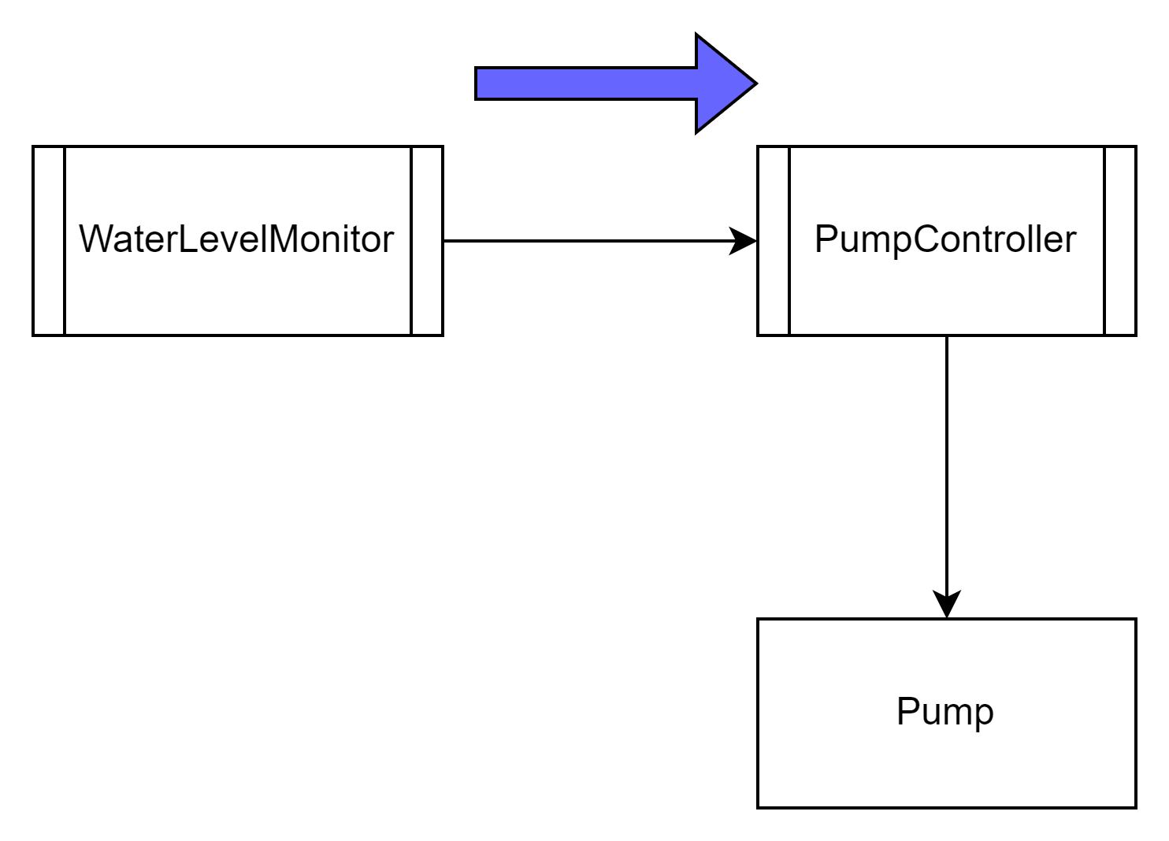
What to do, if we want to decouple the WaterLevelMonitor from the PumpController using the GoF Observer pattern?
Notes:
Let’s look at the part with the Events.

Slide 55
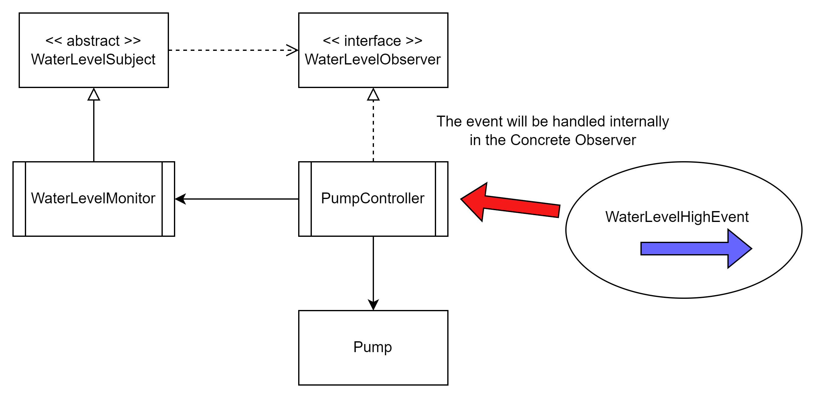
What to do, if we want to decouple the WaterLevelMonitor from the PumpController using the GoF Observer pattern?
Notes:
Let’s look at the part with the Events.

Slide 56
PumpController as Observer
public class PumpController : IWaterLevelObserver
{
private readonly AutoResetEvent _waterLevelHighAutoResetEvent = new AutoResetEvent(false);
private int _waterLevel;
private readonly object _waterLevelLockObject =
new object();
public PumpController(WaterLevelSubject subject)
{
subject.Attach(this);
}
public void Update(int waterLevel)
{
WaterLevel = waterLevel;
_waterLevelHighAutoResetEvent.Set();
}
public void Run()
{
while (!ShallStop)
{
bool wasSet = _waterLevelHighAutoResetEvent.WaitOne(5000);
if (wasSet)
{
Console.WriteLine("Event was set - Water level: " + WaterLevel);
Console.WriteLine("Running pump for 2 seconds.");
}
else
{
Console.WriteLine("Waiting timed out");
}
}
}
public bool ShallStop { get; set; }

Slide 57
PumpController as Observer
public int WaterLevel
{
get
{
lock (_waterLevelLockObject)
{
return _waterLevel;
}
}
set
{
lock (_waterLevelLockObject)
{
_waterLevel = value;
}
}
}

Slide 58
Your turn
Continue with the exercises

Slide 59
References and image sources
Images:
Printer: https://i5.walmartimages.com/asr/5bf8c70c-c0f4-46c8-8de2-d14417c3dcdb_2.a974142a063bb1f235f672f9a68eeb10.jpeg
TPMS: http://www.rematiptop.com/tpms/img/TPMS-warning-light.jpg
Computer keyboard: http://stockmedia.cc/computing_technology/slides/DSD_8790.jpg
Bonus: http://wjreviews.com/reviews-cta/bonus.png

